Slide 1

Hospital Information Management Systems
HIMS

Slide 2

What is HIMS
Health information management (HIM) is the practice of acquiring, analyzing and protecting digital and traditional medical information vital to providing quality patient care.
It is a combination of business, science and information technology.

Slide 3
List of functions that HIMS /software provide
Patient listing And Patient Payments
Appointment Scheduling
Electronic Health Records (EHR)
Electronic Health Records EHR
Billing and Invoicing
Prescription Management
Practice Management
Outpatient Management
Laboratory and Diagnostic Integration
Inpatient Management
Physician Management
Data Management
Insurance Claims Management
Inventory Management
Radiology Management
Revenue Cycle Management
Electronic Medical Billing
Appointment Reminders
Security and Compliance
Reporting and Analytics
Telehealth Integration

Slide 4
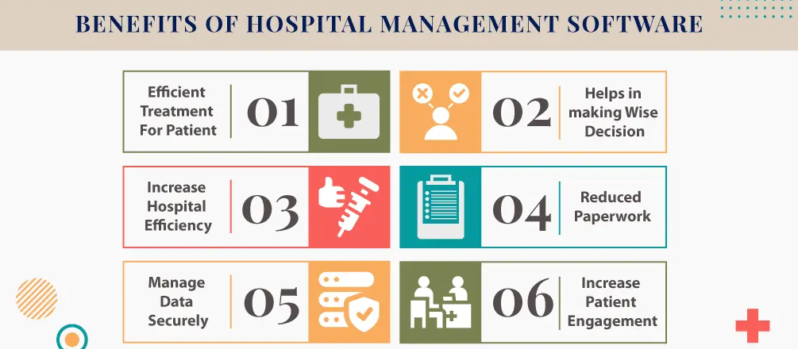

Slide 5

HIMS IN INDIA
India is popular as a leading destination for providing the best healthcare management software due to a combination of factors that set it apart in the global healthcare management software and development industry.
Firstly India really has a huge IT company that can provide or develop the best hospital management system. India has a vast pool of highly expert software developers and IT professionals. These professionals are good in using the latest technologies and have extensive expertise in healthcare software development

Slide 6
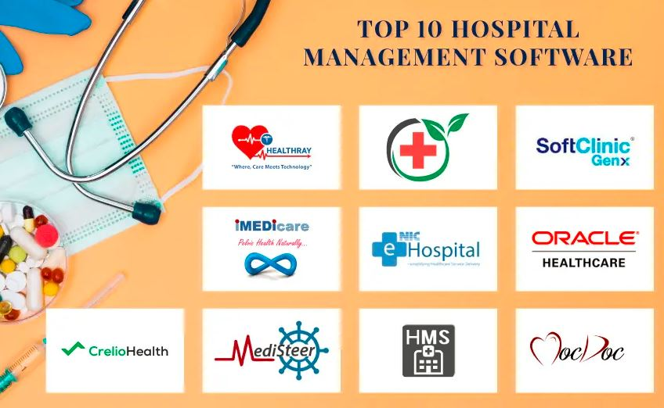

Slide 7

HIMS
HIMs also work on the technology side of securing a patient’s record. The healthcare sector is a prime target for many data breaches and hackers. In 2018, it is documented that the healthcare sector saw over 15 million records compromised in over 500 breaches. With the growth of new technologies, the demand for knowledgeable HIMs will continue to rise.
A HIM involves protecting patient privacy, medical coding and billing, data analysis for medical improvement, and ensuring compliance with laws set by the government. It also includes overseeing the collection, retention, and security of all records for an organization.
The IT sector in healthcare, even before the pandemic, was forecasted to reach $326.1 billion in 2021 and is now predicted to reach $662 billion by 2026.
Up to 83% of patients search for health information on websites and browsers, and the value of the IT healthcare sector is growing by 19.8% per year

Slide 8
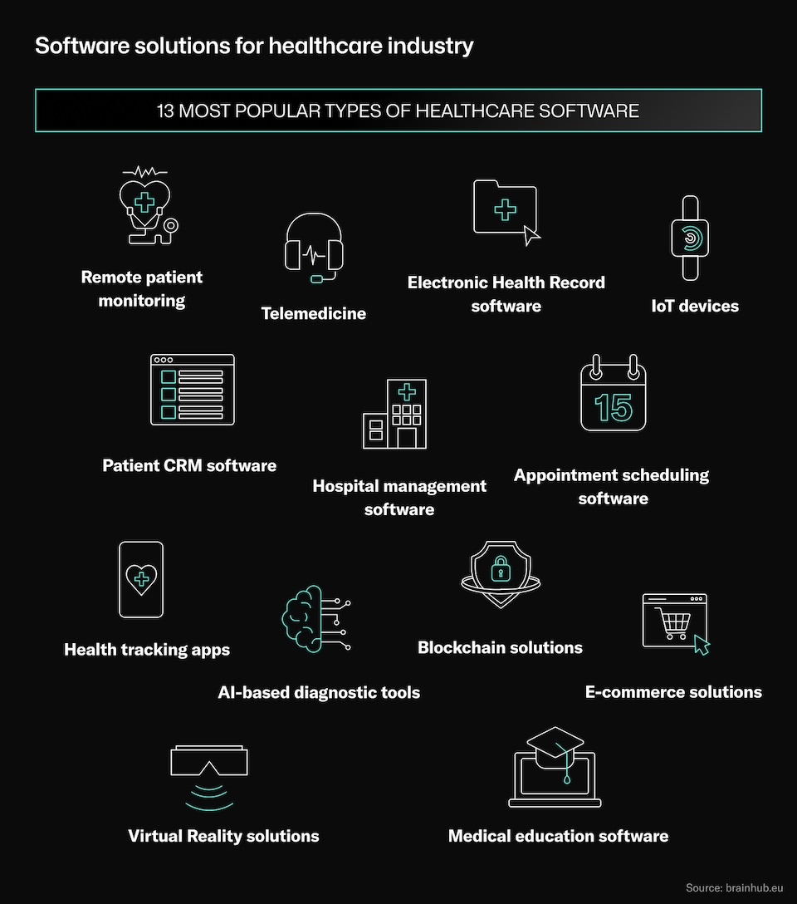

Slide 9
CRM Health tracking apps
CRM software solutions for healthcare are often used by private medical facilities to build relationships with customers and improve their user experience
Most important benefit
Patients get quick access to medical history, treatment data and prescriptions. They can check all the necessary information on their own instead of calling the reception desk of the medical facility.
Use case example
Medicover, Bupa, or Cigna
Health tracking apps send reminders to take measurements, generate periodic reports and support medical education through tips, videos, and posts. They can connect to IoT devices and patient monitoring software.
Use case example:‍QuitNow, Calm,
Clue, Noom

Slide 10
IOT devices AI-based diagnostic tools
Medical IoT devices are used to collect information on a patient's vital functions, such as blood pressure, glucose levels, heart rate, sleep quality, body tension, etc
The patient can easily and effortlessly measure his vitals, and the doctor has access to up-to-date information
Use case examples
‍MorePro's SmartWatch‍
Sensirion ‍
Kinetic
Diagnostic software based on Artificial Intelligence uses machine learning to collect and process data on the symptoms of specific diseases.
Most important benefit
AI-based software used in hospitals increases the accuracy of diagnosis and reduce its time.
Use case example
Diagnostics.ai

Slide 11
Block chain solutions RPM
Blockchain solutions
Private blockchains act as closed databases that can only be accessed by verified users, and their activity is reported in the system
Most important benefit
They enhance data security, ensure transparency of actions taken and prevent information falsification or hacking.
Use case examples
Medical records exchange
Authentication of drug transfers
Verification of insurance data
RPM encompasses all tools, systems, and procedures that allow a person's health to be observed without direct interaction with a medical professional
Advantage:
They enhance data security, ensure transparency of actions taken and prevent information falsification or hacking.
Use case examples
Medical records exchange
Authentication of drug transfers
Verification of insurance data

Slide 12
Telemedicine Electronic health records
Most important benefit
Storage and organization of medical records and the exchange of data between medical facilities.
Use case example
‍AdvancedMD
EHR software maintains the continuity of treatment and significantly reduces administrative work
Most important benefit
Storage and organization of medical records and the exchange of data between medical facilities.
Use case example
‍AdvancedMD

Slide 13
E-commerce solutions Medical education software
E-commerce solutions for healthcare
Patients through an online store can book an appointment with a specialist, purchase a test or examination, a package of appointments with a physical therapist, comprehensive dental treatment, and much more.
Most important benefit
It improves the user experience of healthcare patients, and increases the customer base of healthcare providers.
Use case example
‍Medistore
medical education software can be a tremendous support for students and practicing professionals to improve their skills.
Most important benefit
Improving the quality of education in health care.
Use case example
‍Osso VR
‍Complete Anatomy

Slide 14
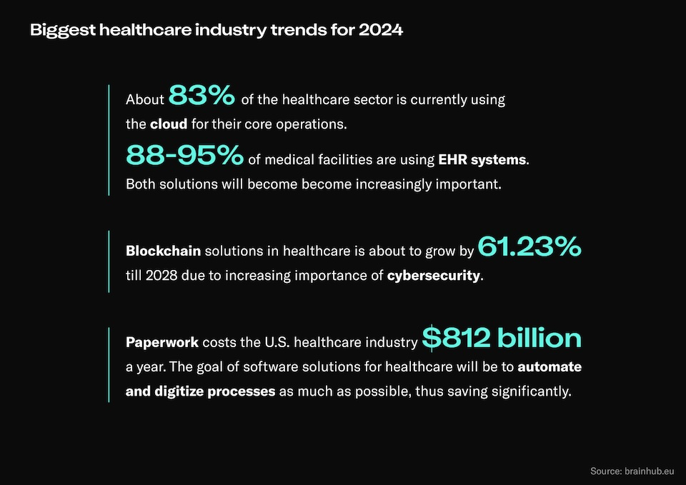

Slide 15
Summary
Digital transformation of healthcare is a process that everyone has been waiting for years, even decades. At first, many companies were afraid of innovation, but once the progress took off - it could no longer be stopped. Today, almost all medical facilities use some form of software to optimize their work. Solutions such as AI-based diagnostic tools, VR software, EHR, CRM, and HMS systems make it possible to significantly increase the productivity of medical staff, avoid administrative errors, save time and money, and, most importantly, improve the quality of patient care. The future is now. And it's remarkable to see what it will bring

